Slide 1

Exploratory Data Analysis (EDA) Report Esivwekpe Efemini 09/10/2025
Title: Cohort Analysis for Assessing Customer Retention in the E-commerce Industry

Slide 2
Introduction
Overview: Founded in 2012 and headquartered in the United States, ShopSphere Inc. began as a niche online marketplace for lifestyle and home essentials. Over time, it has evolved into a comprehensive e-commerce platform offering products across fashion, electronics, home goods, beauty, and wellness.
Growth Highlights:
2014–2016: Expanded into fashion and electronics, achieving 250% traffic growth.
2017: Launched a mobile app, boosting daily transactions.
2019: Rolled out same-day delivery in major U.S. cities.
2021: Surpassed 5 million customers and expanded to the U.K.
2023: Deployed AI-driven product recommendations to enhance personalization.

Slide 3
Objective – Purpose of the Analysis
Goal: To perform Exploratory Data Analysis (EDA) on ShopSphere’s online store data to uncover trends, patterns, and insights that can guide strategic decision-making.
Key Objectives:
Analyze sales performance across product categories, customers, and regions.
Identify customer behavior patterns, including retention and repeat purchase trends.
Evaluate product performance and sales trends over time.
Measure key business metrics and detect correlations between sales drivers.
Deliver actionable insights to support data-driven decisions in marketing, loyalty programs, and personalized recommendations.

Slide 4
Dataset Overview
Dataset Name: Cohort Analysis for Assessing Customer Retention in the E-commerce Industry
Data Summary
Metrics Description
Time Period Jan 2021– Sept 2024
Rows 385314
Columns InvoiceNo, InvoiceDate, CustomerID, StockCode, Description,Quantity, UnitPrice, Country
Country United States,United Kingdom

Slide 5
Data Cleaning & Preproccessing
Created a new column for Revenue.
Group Dataset by Country and Revenue to see country with the most spend.
Converted InvoiceDate to Pandas DateTime format.
Check for missing Data in the Dataset.

Slide 6

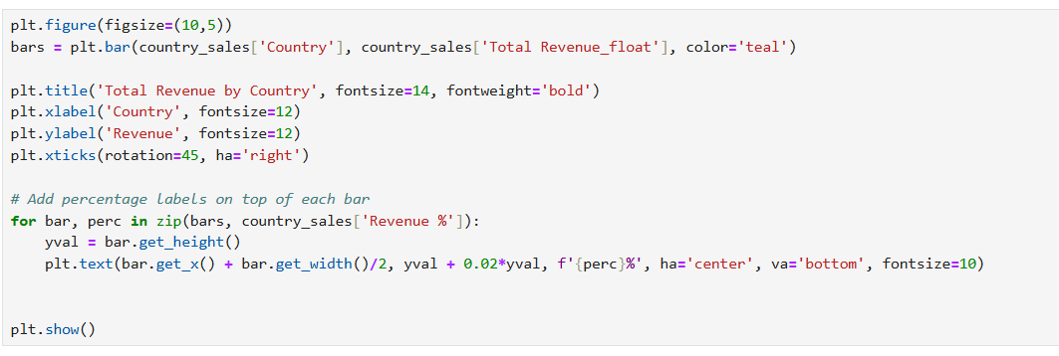
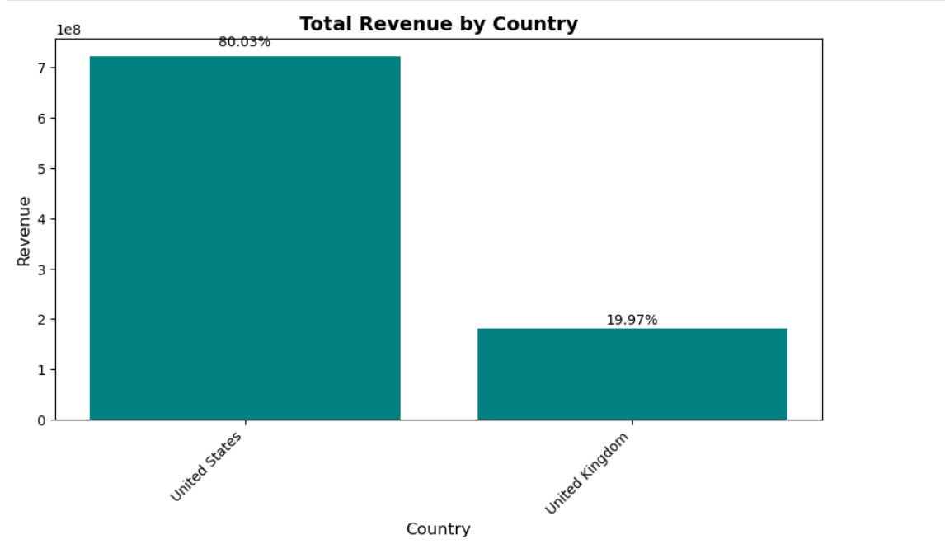
Customer Insights
GEOGRAPHICAL INSIGHTS
The U.S. is ShopSphere’s leading market, accounting for over half of total sales.
The U.K. shows stable performance, while other regions contribute modestly.
Growth opportunities exist in emerging markets with rising sales activity.

Slide 7
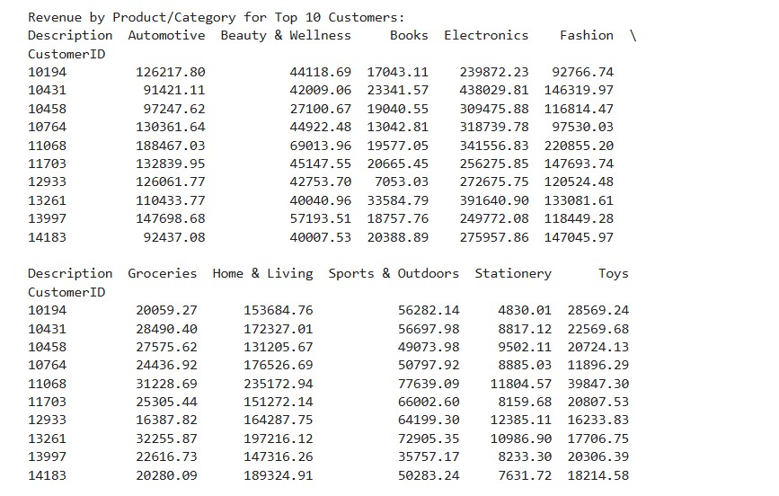
Customer Insights
TOP TEN SPENDERS

Slide 8
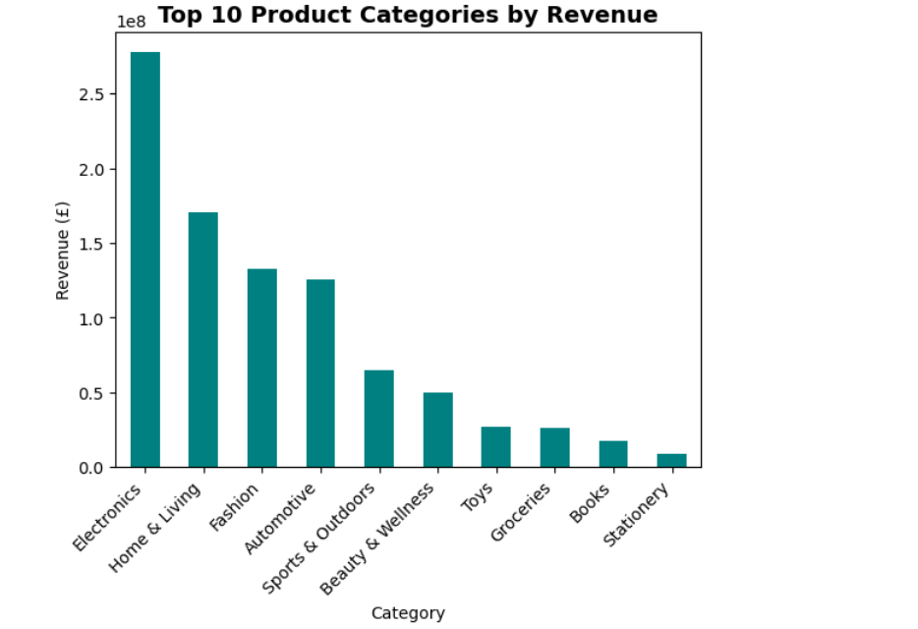
Top 10 Product Categories by Revenue
Above, we are able to see what products generates the most revenue for the Shopsphere.This matters because some customers might buy less frequently, but their purchases are high-value (high-revenue) and a sign of premium loyalty. Identifying these products helps focus retention strategies on high-spend repeat customers.

Slide 9
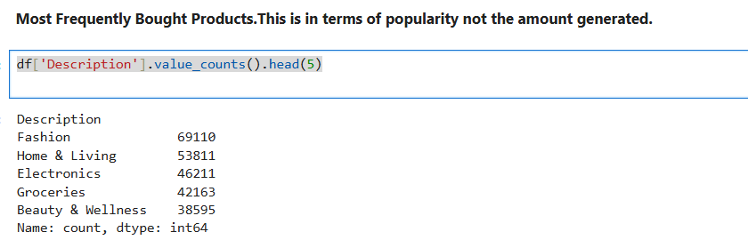
Most Frequently Bought Products. This is in terms of popularity not the amount generated
Even though the analysis result above is focused on products ,they tell stories that help assess retention. It tells which products or categories are most frequently purchased across transactions, Helps to identify "staple" products that drive repeat engagement and also frequent items indicate high customer familiarity often what brings customers back. Fashion items and Electronics appear most frequently in the transactions.

Slide 10
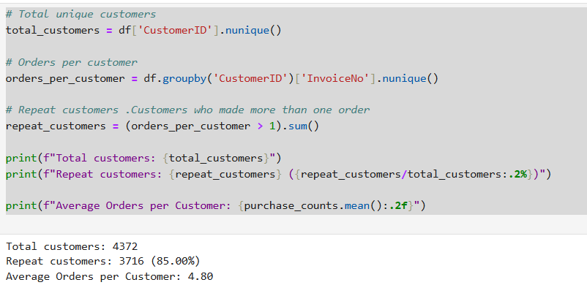
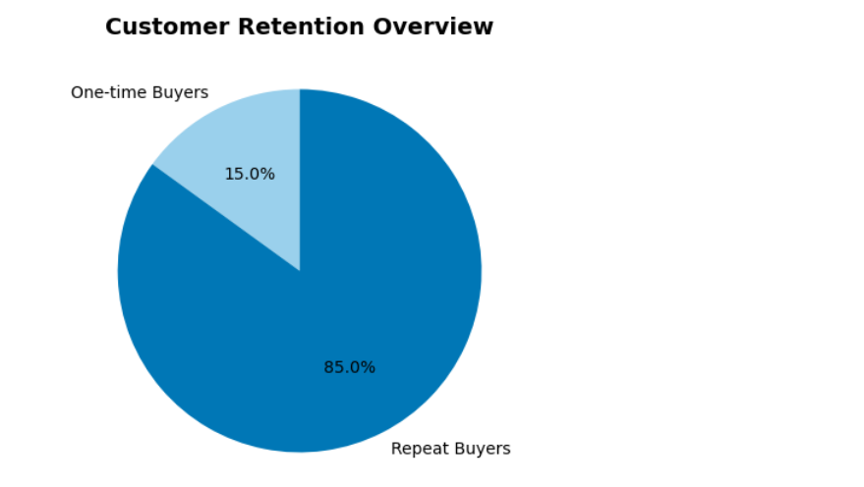
Total customers and repeat buyers
So Out of 4372 customers, 3716 (85%) made more than one purchase .This indicates that tye retention is above moderate. Average orders per customer = 4.80

Slide 11
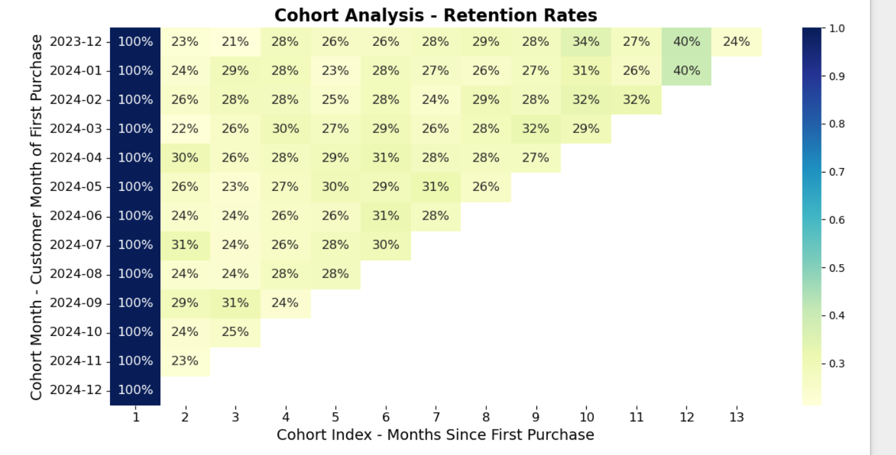
📊 Customer Retention Analysis Summary
We conducted a cohort analysis to understand how customer retention evolves over time. Each row in the table represents a group of customers who made their first purchase in a given month (the CohortMonth). Each column shows a percentage of how many of those customers returned in subsequent months (the CohortIndex, or months since first purchase

Slide 12
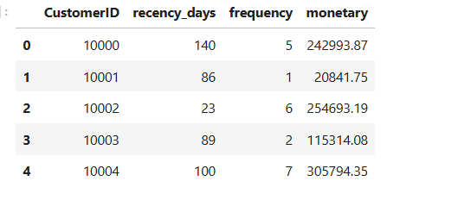
RFM Analysis – Segmenting Our Customers
RFM stands for:
Recency: Days since last purchase (lower = more recent)
Frequency: Number of purchases (higher = more loyal)
Monetary: Total spend (higher = more valuable).
Helps us identify VIPs, loyal customers, and at-risk segments, Enables targeted marketing and personalized engagement, Drives data-backed decisions for retention and growth

Slide 13
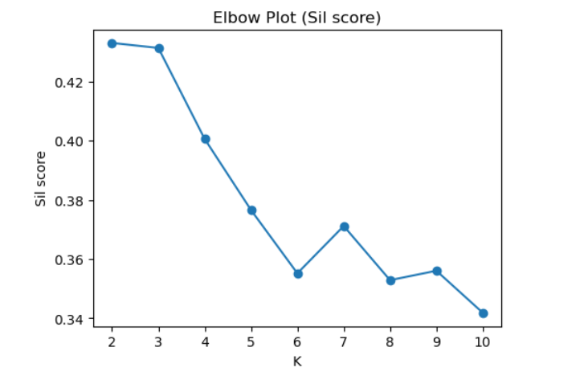
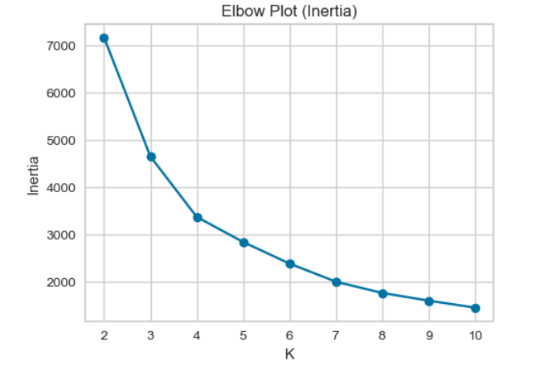
Determining Optimal Customer Segments with K-Means
Inertia measures are tightly grouped the clusters are while sil score measures are well separated the clusters are.

Slide 14
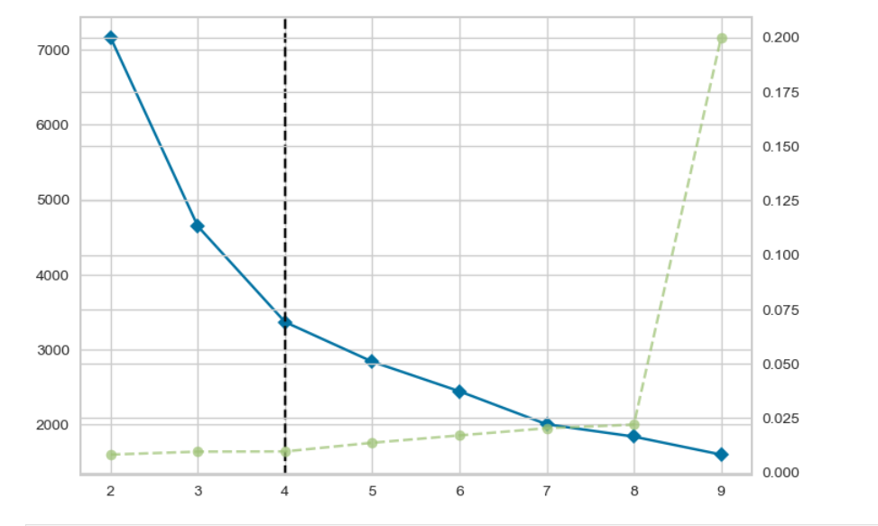
Using the YellowBrick Methid
This method combines both inertia and visual interpretation into one intuitive plot, making it easier to spot the optimal number of clusters.

Slide 15
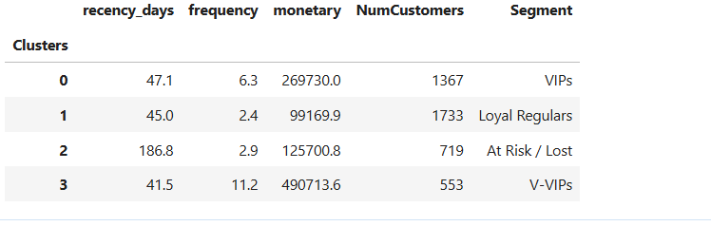
PROFILE CLUSTERING
Here, we have now grouped the customers based on their contribution and patronage.

Slide 16
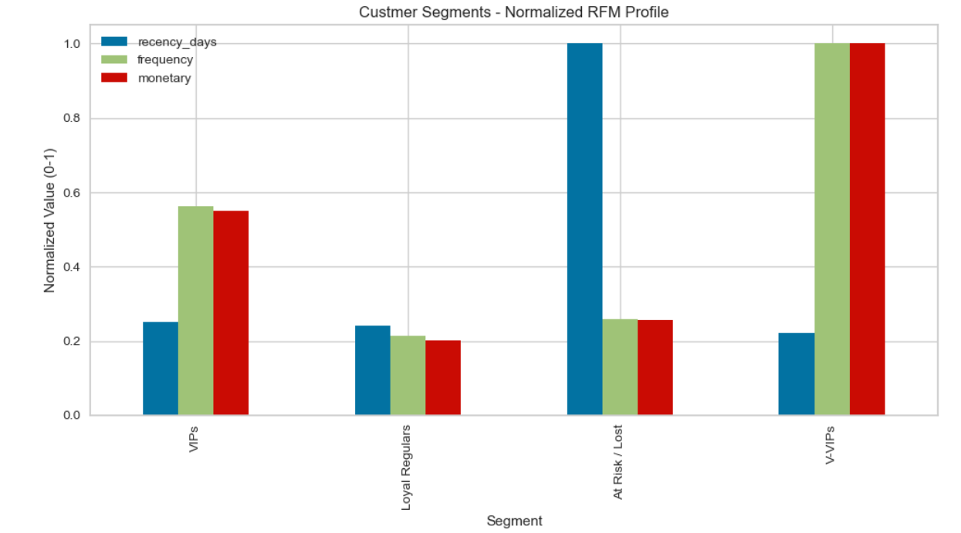
Customer Segments – RFM Analysis Insights
The chart shows normalized Recency, Frequency, and Monetary (RFM) values across four key customer segments: VIPs, Loyal Regulars, At Risk/Lost, and V-VIPs
V-VIPs:
Highest frequency and monetary scores (both normalized to 1).
Indicate extremely valuable, highly engaged customers with consistent purchases.
VIPs:
Moderate recency but strong frequency and spending patterns.
Represent high-potential customers who could be nurtured into V-VIPs.
Loyal Regulars:
Balanced across all metrics but slightly lower on spending.

Slide 17
Retention Strategies by Customer Segment
At Risk / Lost Customers
Reach out with exclusive offers or seasonal discounts to reignite interest and encourage a fresh purchase.​
Ask for feedback with friendly surveys, showing genuine interest in their experience and improvement suggestions.​
Make reactivation simple—short emails, easy return policies, and limited-time “welcome back” incentives.
.

Slide 18
Loyal Regulars
Loyalty Programs: Reward consistent customers with points, special discounts, or exclusive deals to reinforce loyalty.​
Upselling/Cross-selling: Introduce complementary products hoping to increase their spend per visit.​
Community Engagement: Invite participation (reviews, social media, product feedback) to foster stronger brand connections.

Slide 19
VIPS and VVIPS
Personalized Experiences: Send bespoke offers, early access to new products, and personalized communication for top-tier customers.​
Recognition & Appreciation: Celebrate milestones and offer premium rewards to make VIPs feel valued.​
Retention Focus: Maintain high engagement with regular check-ins, invitations to exclusive events, and enhanced loyalty rewards to prevent defection

Slide 20
THANK YOU

